Slide 1
ENVIRONMENT PROVISIONING USING ADOP BLUEPRINT
Day 15

Slide 2
AGENDA

Slide 3
AGENDA
Brief Overview of DevOps
What is a Environment?
What is Cloud Computing?
What is Amazon Web Services?
What is AWS Cloud Formation?
What is ADOP Blueprint?
Brief Overview of ADOP GEN5 Architecture
Brief Overview of ADOP using CloudFormation
Template Anatomy
Q&A

Slide 4
What is DevOps?

Slide 5



What is DevOps?
practice of operations and development engineers
DevOps
involved in the entire service lifecycle
hastens the delivery and integration of processes
How DevOps Principles Accelerate Software Delivery
“DevOps uses automation techniques to optimize collaboration across development and operations, enabling faster, more predictable and more frequent deployments to market"
Development
Operations
Test early and often
Improve continuously
Automate everything
Cohesive teams
Strong source control
Deliver small increments
Experiment frequently without regret
Traditional Development
5
Notes:
Environment refers to the collection of hardware and software tools a system developer uses to build software systems.
The Development environment is where developers live and breathe, where they make all the changes, mistakes and fixes that you need. It’s like a small lab where nobody judges you, where it does not matter if you break the CSS or your whole webpage as nobody is going to notice. Once you achieve something, like developing a new item of a list, fix a bug, or a new functionality, you should stop and move your functionality to the Testing environment.
The Testing / Staging environment is a little different. Actually, there is a slight difference between testing and staging environments, but to distinguish them is not the point here. You need something that acts as a copy of your corporate site, a copy of the live version. It should be EXACTLY the same, because you are going to test in this environment your new developments, you want to know how it will work and IF it will work live before going live. Only once you have verified that everything works, that your new functionality has not broken anything, you can migrate the changes to the production environment.
Finally, the Production environment. It is the live version of your site / software. You should only use in this environment things that you are 100% will work and that have been tested. You should NEVER make changes in production directly. It sounds easy to follow but it isn’t. When you see that you can “fix” something easily in production, hold that thought. Even if it is just one line of code, don’t do it, test it before. Some of the reasons to ALWAYS follow this rule is that a small change can break things, and that if you skip one of this steps you risk creating glitches between your different environments which in turn will increase the possibility of new failures.
The number of places where this simple rule is not followed is still huge, and the worst of it all is that the reason in most cases is pure human laziness, not computational complexity.After all, it’s actually an easy to follow rule:
Experiment on the development environment, Test it on the Test environment and if it works Migrate the changes to the Production environment.

Slide 6
What is an Environment?

Slide 7
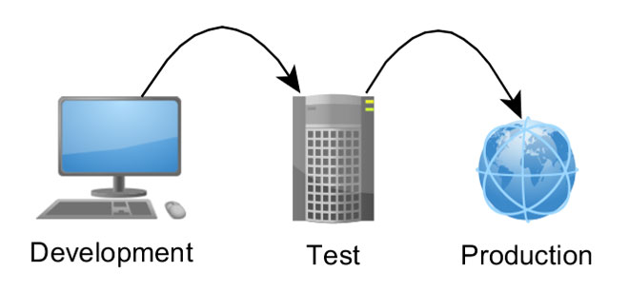
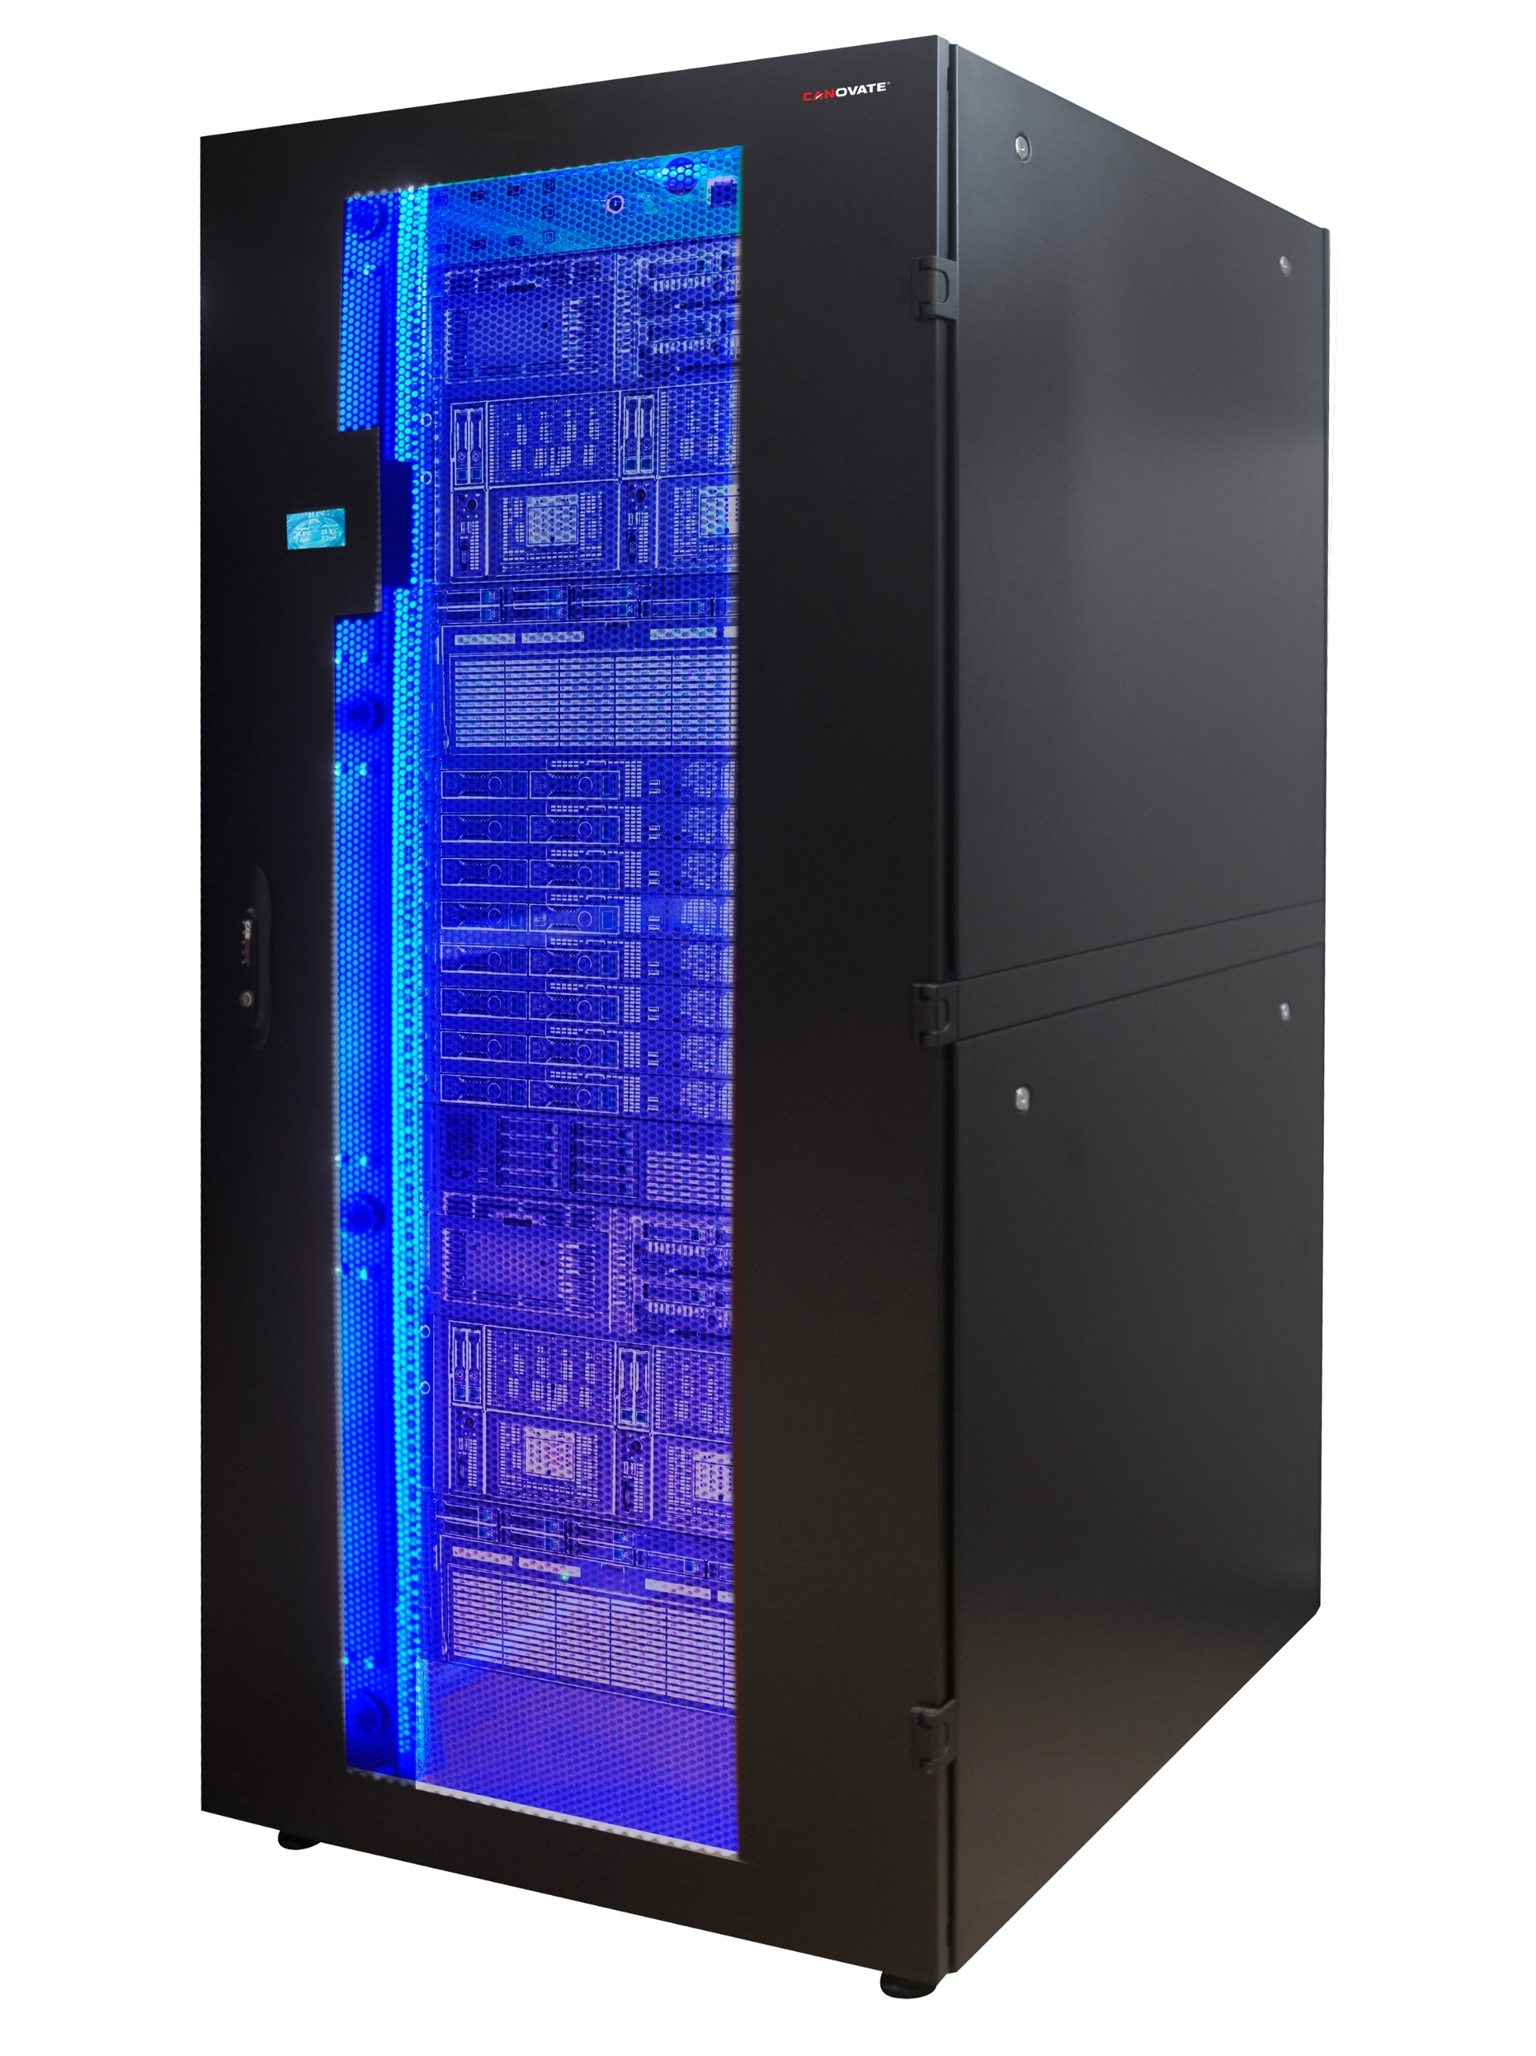
What is an Environment?
In software deployment, an environment or tier is a computer system in which a computer program or software component is deployed and executed.
Development
Working in isolation with the rest of the tiers, the developer(s) can try radical changes to the code without adversely affecting the rest of the development team.
Integration
A common environment where all developers commit code changes.
Combine and validate the work of the entire project team so it can be tested before being promoted to the Staging Environment.
Possible for Development and Integration to be the same environment
Staging/Test
Identical to the production environment as possible.
Simulate as much of the Production environment as possible
Production
Production tier might include a single machine or a huge cluster comprising many machines.
Notes:
Environment refers to the collection of hardware and software tools a system developer uses to build software systems.
The Development environment is where developers live and breathe, where they make all the changes, mistakes and fixes that you need. It’s like a small lab where nobody judges you, where it does not matter if you break the CSS or your whole webpage as nobody is going to notice. Once you achieve something, like developing a new item of a list, fix a bug, or a new functionality, you should stop and move your functionality to the Testing environment.
The Testing / Staging environment is a little different. Actually, there is a slight difference between testing and staging environments, but to distinguish them is not the point here. You need something that acts as a copy of your corporate site, a copy of the live version. It should be EXACTLY the same, because you are going to test in this environment your new developments, you want to know how it will work and IF it will work live before going live. Only once you have verified that everything works, that your new functionality has not broken anything, you can migrate the changes to the production environment.
Finally, the Production environment. It is the live version of your site / software. You should only use in this environment things that you are 100% will work and that have been tested. You should NEVER make changes in production directly. It sounds easy to follow but it isn’t. When you see that you can “fix” something easily in production, hold that thought. Even if it is just one line of code, don’t do it, test it before. Some of the reasons to ALWAYS follow this rule is that a small change can break things, and that if you skip one of this steps you risk creating glitches between your different environments which in turn will increase the possibility of new failures.
The number of places where this simple rule is not followed is still huge, and the worst of it all is that the reason in most cases is pure human laziness, not computational complexity.After all, it’s actually an easy to follow rule:
Experiment on the development environment, Test it on the Test environment and if it works Migrate the changes to the Production environment.

Slide 8
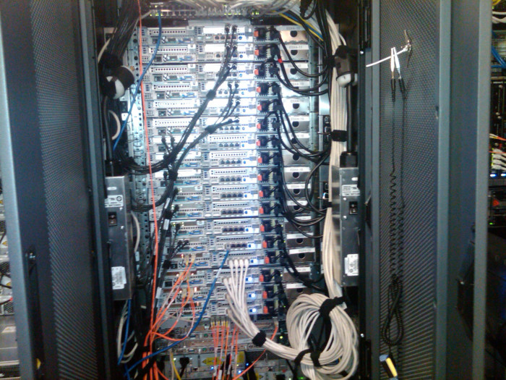
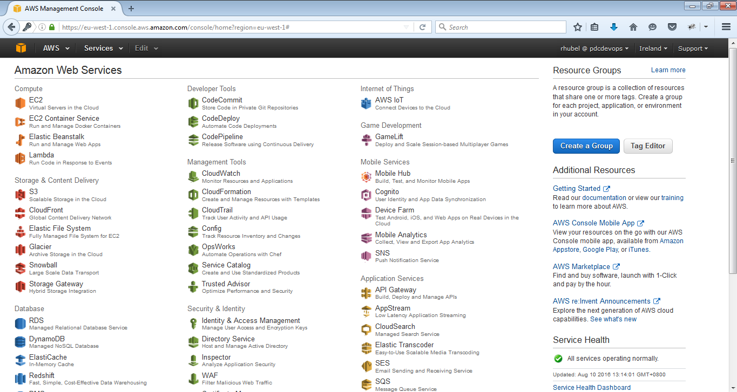
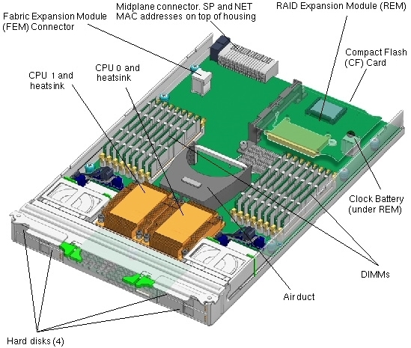
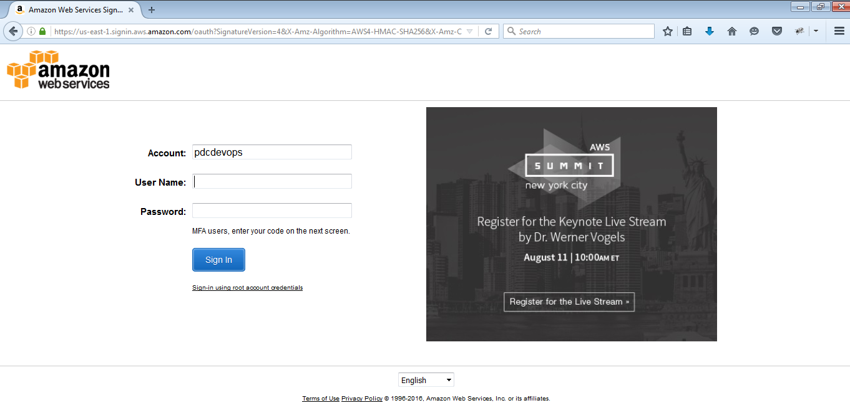
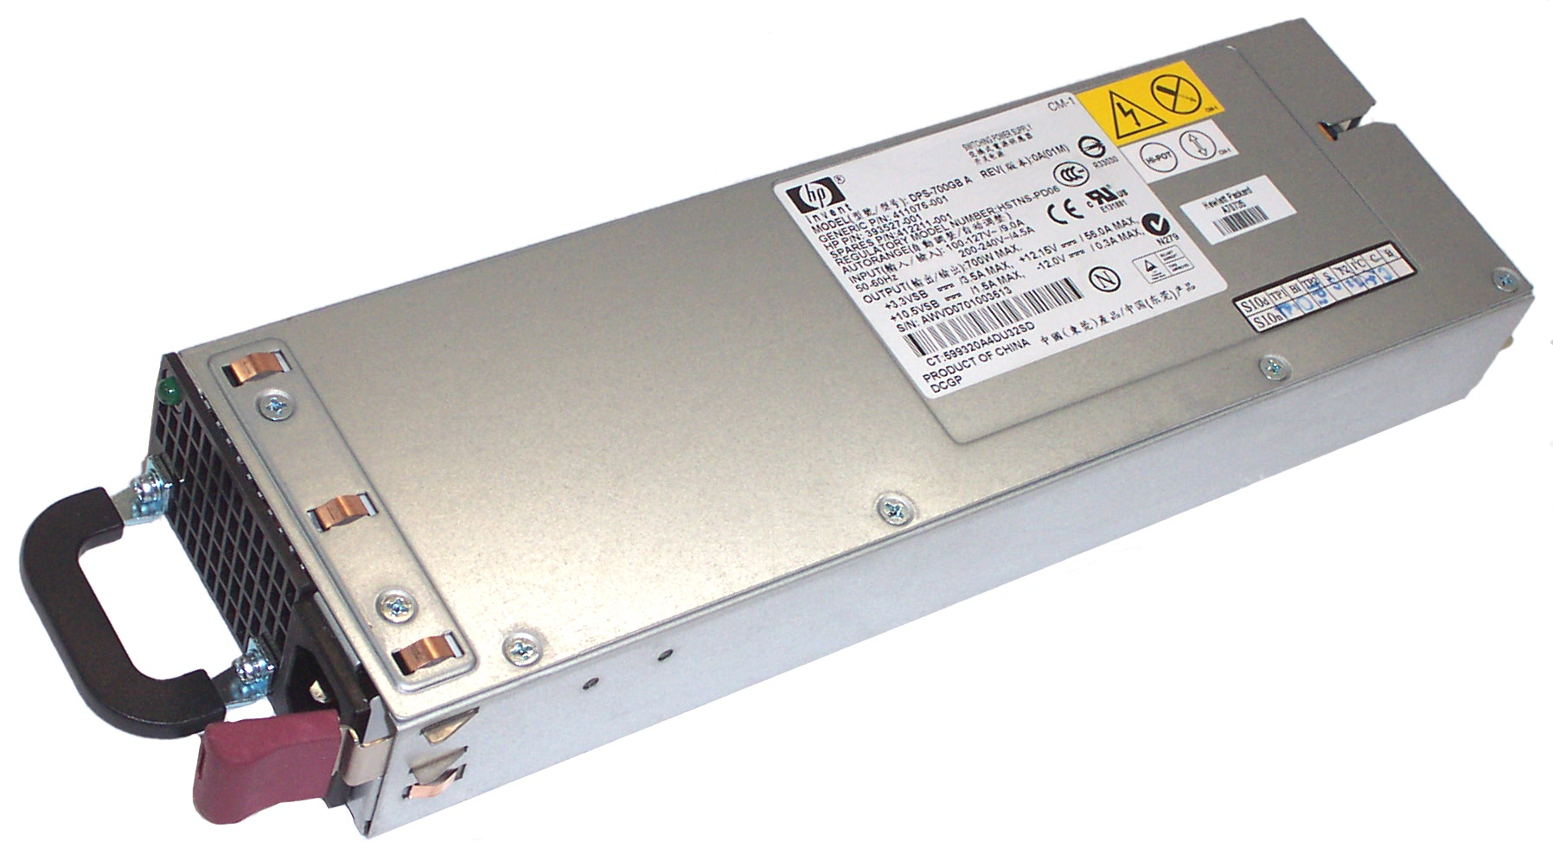
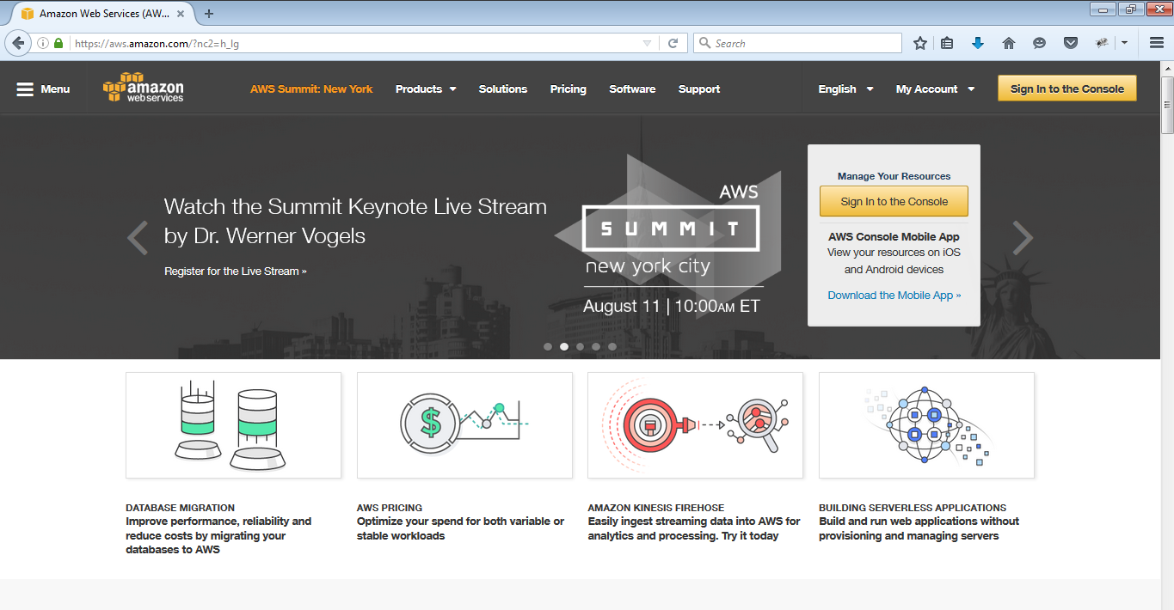
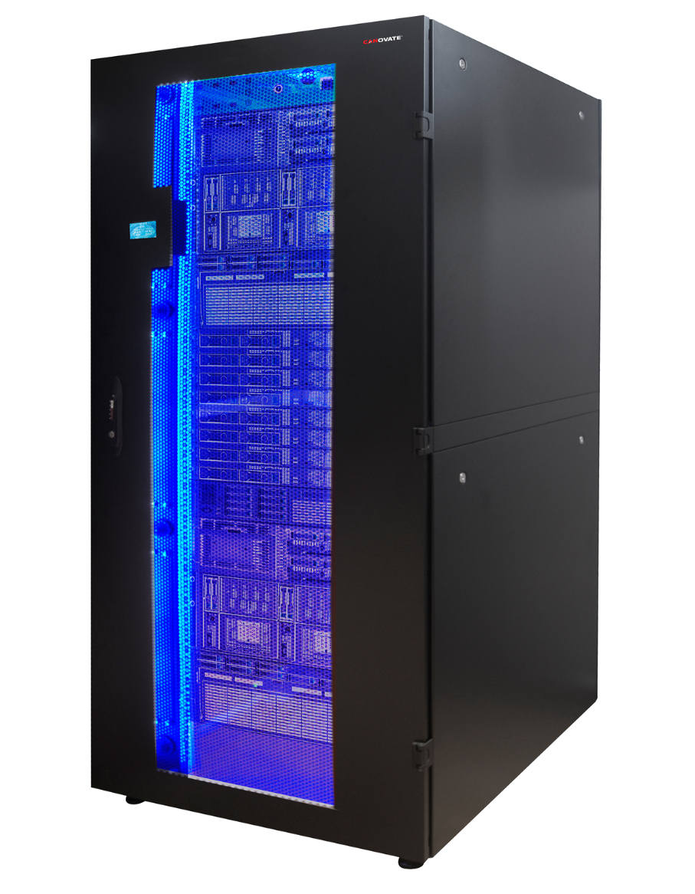


What is an Environment?
Traditional Hosting
Cloud Hosting
Copyright © 2015 Accentue All Rights Reserved.
Notes:
Physical Servers
Getting a physical server involves several steps, as follows.
Once you hire us to get one, we call the hardware provider (Dell in our case) and wait for several days for the hardware to arrive at our offices in Sweden. With the hardware here, one of our technicians locate a free rack unit, install the server, connect the corresponding cables and power supply and after talking to the customer, the desired operating system is installed.
After a few basic diagnostics and with the operating system ready to go, users are delivered their credentials. After this, you can remotely access your server and start setting up whatever software you wish. At this point, control is up to you and we only intervene for reboots and hardware changes. Although once configured, this is a rare occurrence. The servers we use from Dell have great quality hardware, redundant disks and all kind of components built to last.
We take care, of course, of the network and make sure you have fast connectivity at all times. Top of the line Cisco routers and switches, redundant refrigeration and continuous power ensure you won´t get any hiccups under normal circumstances.
The server runs non-stop until the end of times, or until you decide to stop using it.
Virtual Servers
Virtual dedicated servers or Infrastructure as a Service as it´s commonly known is a way of having your own machine and while the end result is similar, the way to order one is different.
You start by registering an account (here at City Cloud), and when you have confirmed your email and identity, you get access to our control panel. From there, you just click on “New VM”, select the operating system and/or image (some of them come with pre-installed software ready to go) and wait a few minutes.
That´s right, after a few minutes you get a new virtual machine that can be accessed by SSH or VNC. The IP address is assigned automatically so you have everything you need to start installing software.
Servers run continuously until you turn them off, which can be done with literally one click. You can then clone them, erase them, turn them back on or just leave them paused.
Since you pay by the hour and by capacity, you can increase and decrease power and cost between minutes. Choice is really up to you or your application, since this can also be automated.
Reduced IT costs
Moving to cloud computing may reduce the cost of managing and maintaining your IT systems. Rather than purchasing expensive systems and equipment for your business, you can reduce your costs by using the resources of your cloud computing service provider. You may be able to reduce your operating costs because:
the cost of system upgrades, new hardware and software may be included in your contract
you no longer need to pay wages for expert staff
your energy consumption costs may be reduced
there are fewer time delays.
Scalability
Your business can scale up or scale down your operation and storage needs quickly to suit your situation, allowing flexibility as your needs change. Rather than purchasing and installing expensive upgrades yourself, your cloud computer service provider can handle this for you. Using the cloud frees up your time so you can get on with running your business.
Business continuity
Protecting your data and systems is an important part of business continuity planning. Whether you experience a natural disaster, power failure or other crisis, having your data stored in the cloud ensures it is backed up and protected in a secure and safe location. Being able to access your data again quickly allows you to conduct business as usual, minimising any downtime and loss of productivity.
Collaboration efficiency
Collaboration in a cloud environment gives your business the ability to communicate and share more easily outside of the traditional methods. If you are working on a project across different locations, you could use cloud computing to give employees, contractors and third parties access to the same files. You could also choose a cloud computing model that makes it easy for you to share your records with your advisers (e.g. a quick and secure way to share accounting records with your accountant or financial adviser).
Flexibility of work practices
Cloud computing allows employees to be more flexible in their work practices. For example, you have the ability to access data from home, on holiday, or via the commute to and from work (providing you have an internet connection). If you need access to your data while you are off-site, you can connect to your virtual office, quickly and easily.
Access to automatic updates
Access to automatic updates for your IT requirements may be included in your service fee. Depending on your cloud computing service provider, your system will regularly be updated with the latest technology. This could include up-to-date versions of software, as well as upgrades to servers and computer processing power.
The Pros and Cons of Physical Servers
A physical server is piece of equipment on which data is stored and read. This may be located onsite in your server room, or it could be stored at a colocation facility (a data center) with a trusted vendor. Physical servers are generally owned, managed, and maintained by your company's staff.
Pros of Physical Servers
Your IT team has full access to your dedicated server resources 24/7/365, which can be advantageous for high-demand or business-critical operations.
Depending on your needs, the server may be located onsite or in a conveniently-located colocation facility.
Your IT staff can fully customize and configure the server to your specifications and business requirements.
Cons of Physical Servers
Relatively high cost of server purchase, maintenance, and in the case of hardware failure, replacement.
Your IT staff will be responsible for setup, configuration, and maintenance on a continual basis.
You may need to hire a contractor or vendor for help if you have difficulty with configuration or repairs.
Users cannot scale storage in small increments once you reach the maximum workload, since you purchase and own the hardware.
Requires physical or colocation space.
The Pros and Cons of Virtual Servers
Virtualization is the act of placing multiple "virtual servers" on physical equipment. This allows physical server resources to be split between multiple workloads for maximum efficiency and cost savings. Virtualization typically occurs in the cloud or on servers that are owned, maintained, and located offsite. Hiring a hosting vendor who offers secure cloud services is the most common way that organizations switch to virtualization.
Pros of Virtual Servers
Fewer upfront costs, since you are not required to purchase hardware.
Potential for lower lifetime costs on configuration and maintenance.
Access to expert assistance on setup, configuration, maintenance, and software licenses.
Reduced need for in-house IT talent.
Potential to consolidate servers and increase workload efficiency.
Reduced environmental footprint, due to shared workloads.
Cons of Virtual Servers
Potential for higher recurring monthly costs, as opposed to higher upfront investment.
Possible issues with application compatibility, which are best discussed with a knowledgeable vendor.
Not all vendors are amenable to scaling your agreement up or down in small increments, which largely depends on vendor policies and service level agreements (SLAs).
You are no longer independently in control of your physical server and the applications running on them.

Slide 9
What is Cloud Computing?

Slide 10
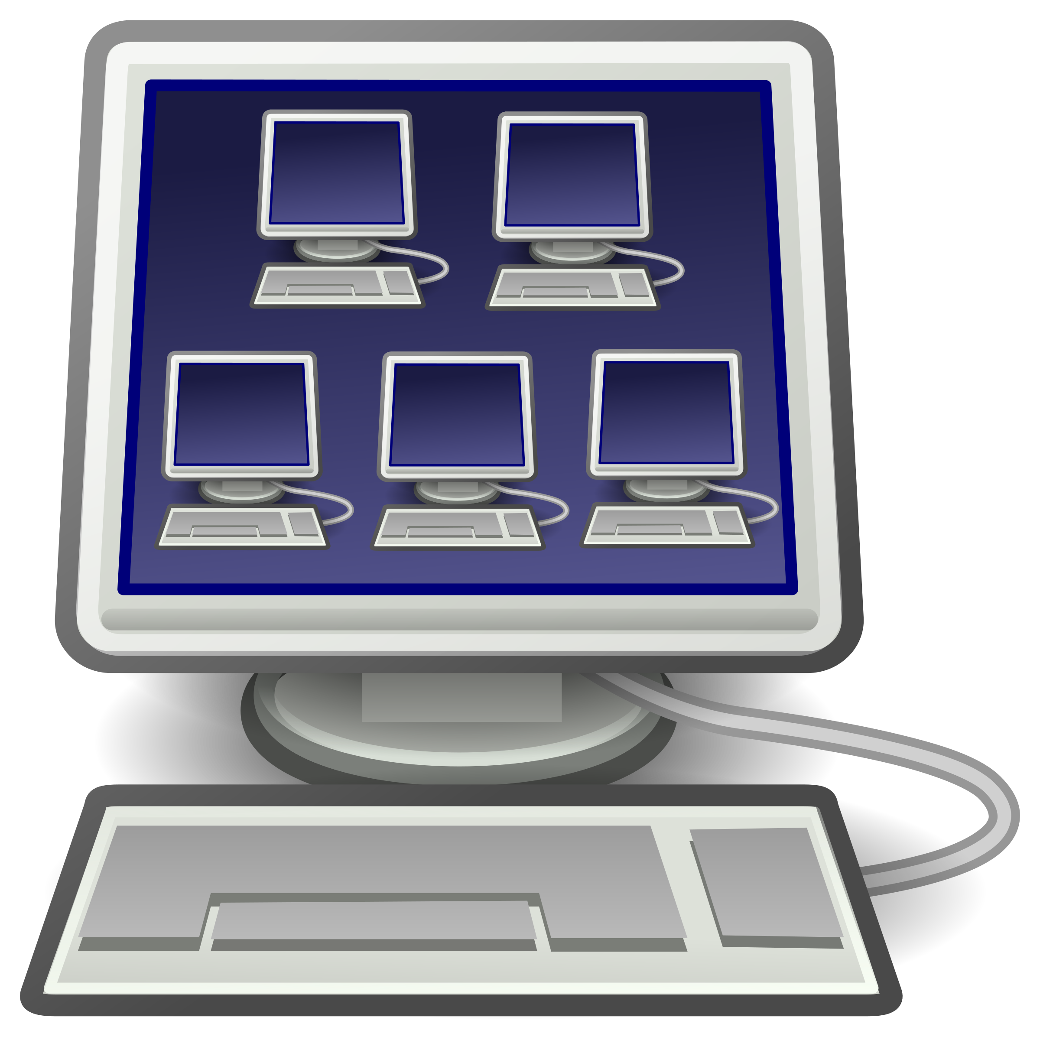
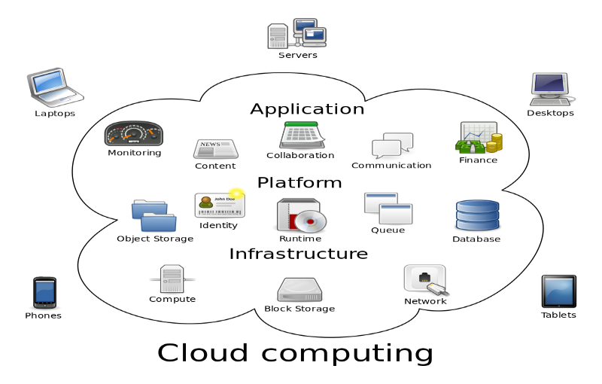
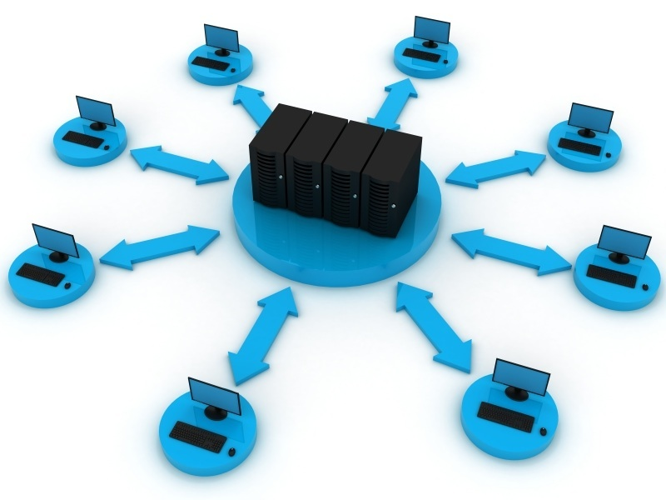
What is Cloud Computing?
refers to the on-demand delivery of IT resources and applications via the Internet with pay-as-you-go pricing.
provides a simple way to access servers, storage, databases and a broad set of application services over the Internet.
A combination of both Virtualization and Grid, but the end user does not have to care about the underlying architecture
Categories of Cloud Computing
Infrastructure as a Service (IaaS)
Platform as a Service (PaaS)
Software as a Service (SaaS)
Virtualization
One computer acting like many
Grid Computing
Many computers acting like one
Notes:
Cloud Computing is a collection of computing services (compute, storage, network, applications, etc.) accessible on-demand over a network. It is a business and technology model for delivering and acquiring IT services in a utility-like fashion. Pay-as-you go pricing means that the resources can be commissioned or decommissioned anytime you want, you only pay for the exactly amount of time the resources has been used.
Cloud Computing addresses many of the limitations of traditional, on premise IT infrastructure. Cloud computing provides customers with access to remote computing resources, delivered as a service, over the internet. With cloud computing, customers no longer have to purchase and maintain the hardware required to roll out new business applications. Instead, cloud computing allows developers to access computing resources remotely, at any time, through a web browser or through APIs.
Utility computing is a service provisioning model in which a service provider makes computing resources and infrastructure management available to the customer as needed, and charges them for specific usage rather than a flat rate.

Slide 11
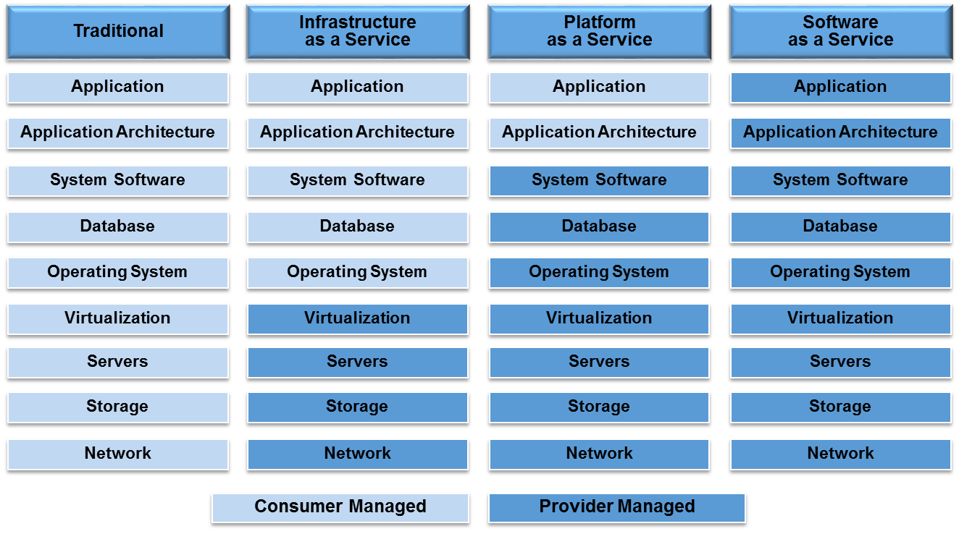
What is Cloud Computing?
Categories of Cloud Computing
Notes:
Cloud Computing is a collection of computing services (compute, storage, network, applications, etc.) accessible on-demand over a network. It is a business and technology model for delivering and acquiring IT services in a utility-like fashion.
Cloud Computing addresses many of the limitations of traditional, on premise IT infrastructure. Cloud computing provides customers with access to remote computing resources, delivered as a service, over the internet. With cloud computing, customers no longer have to purchase and maintain the hardware required to roll out new business applications. Instead, cloud computing allows developers to access computing resources remotely, at any time, through a web browser or through APIs.
Utility computing is a service provisioning model in which a service provider makes computing resources and infrastructure management available to the customer as needed, and charges them for specific usage rather than a flat rate.
Cloud services provide numerous choices to an IT organization. The overhead in managing some of the underlying technology is transferred to the cloud provider

Slide 12
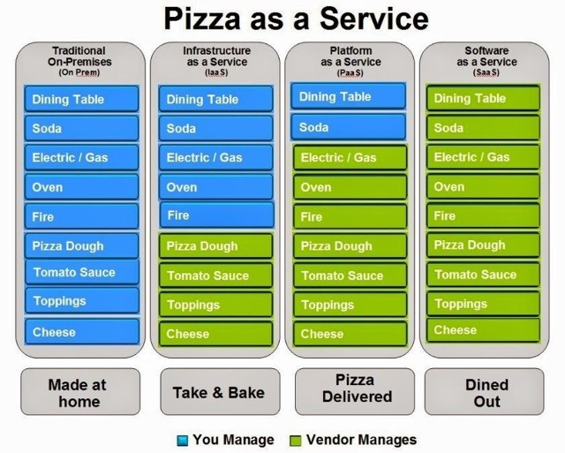
What is Cloud Computing?
Categories of Cloud Computing
Notes:
Cloud Computing is a collection of computing services (compute, storage, network, applications, etc.) accessible on-demand over a network. It is a business and technology model for delivering and acquiring IT services in a utility-like fashion.
Cloud Computing addresses many of the limitations of traditional, on premise IT infrastructure. Cloud computing provides customers with access to remote computing resources, delivered as a service, over the internet. With cloud computing, customers no longer have to purchase and maintain the hardware required to roll out new business applications. Instead, cloud computing allows developers to access computing resources remotely, at any time, through a web browser or through APIs.
Utility computing is a service provisioning model in which a service provider makes computing resources and infrastructure management available to the customer as needed, and charges them for specific usage rather than a flat rate.
Cloud services provide numerous choices to an IT organization. The overhead in managing some of the underlying technology is transferred to the cloud provider

Slide 13
Features and Benefits

Slide 14
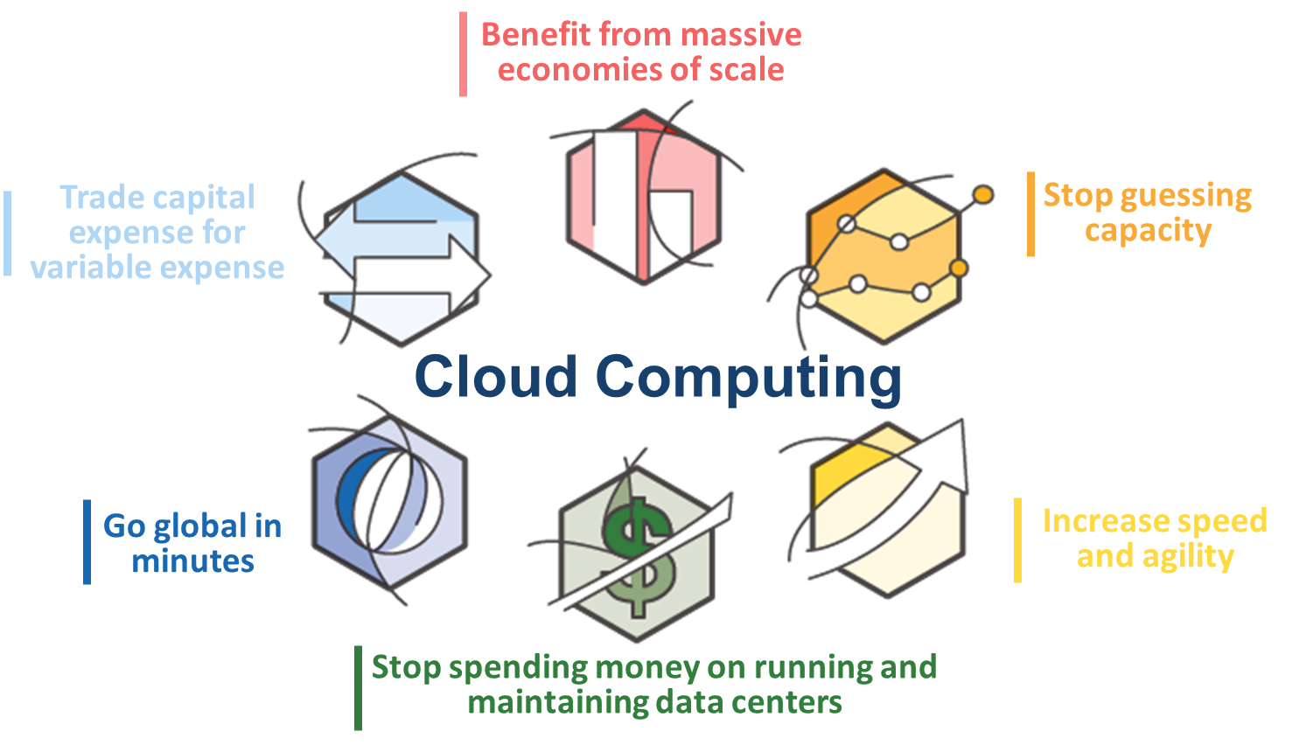
Features and Benefits
Notes:
Trade capital expense for variable expense
Instead of having to invest heavily in data centers and servers before you know how you’re going to use them, you can only pay when you consume computing resources, and only pay for how much you consume.
Benefit from massive economies of scale
By using cloud computing, you can achieve a lower variable cost than you can get on your own. Because usage from hundreds of thousands of customers are aggregated in the cloud, providers such as Amazon Web Services can achieve higher economies of scale which translates into lower pay as you go prices.
Stop guessing capacity
Eliminate guessing on your infrastructure capacity needs. When you make a capacity decision prior to deploying an application, you often either end up sitting on expensive idle resources or dealing with limited capacity. With Cloud Computing, these problems go away. You can access as much or as little as you need, and scale up and down as required with only a few minutes notice.
Increase speed and agility
In a cloud computing environment, new IT resources are only ever a click away, which means you reduce the time it takes to make those resources available to your developers from weeks to just minutes. This results in a dramatic increase in agility for the organization, since the cost and time it takes to experiment and develop is significantly lower.
Stop spending money on running and maintaining data centers
Focus on projects that differentiate your business, not the infrastructure. Cloud computing lets you focus on your own customers, rather than on the heavy lifting of racking, stacking and powering servers.
Go global in minutes
Easily deploy your application in multiple regions around the world with just a few clicks. This means you can provide a lower latency and better experience for your customers simply and at minimal cost.

Slide 15
What is Amazon Web Services?

Slide 16
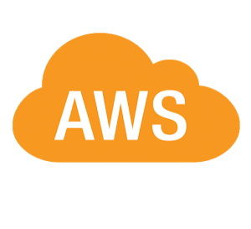
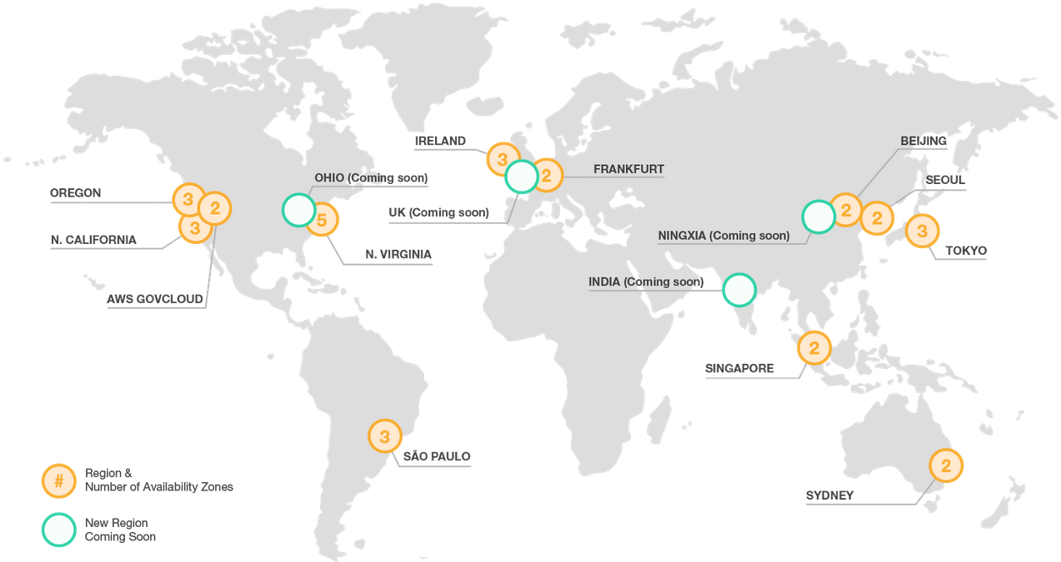
What is Amazon Web Services?
Provides computing resources and services that you can use to build applications within minutes.
Operate from 13 geographical regions across the world.
has more than 70 services that span a wide range including compute, storage, networking, database, analytics, application services, deployment, management, mobile, developer tools and tools for the Internet of things.
The most central and best-known of these services arguably include Amazon Elastic Compute Cloud (EC2) and Amazon Simple Storage Service (S3).
Notes:
So lets look at Amazon Web Services, AWS started with the vision of making everything as a web service. It launched in 2006 when it when it began offering developer access to IT infrastructure in the form of web services – now commonly known as cloud computing. Amazon Web Services (AWS) provides computing resources and services that you can use to build applications within minutes at pay-as-you-go pricing. Pay-as-you go pricing means that the resources can be commissioned or decommissioned anytime you want, you only pay for the exactly amount of time the resources has been used.
Low Cost- Building on-premise infrastructure can be slow and expensive. Many components need to be in place before you or your customer can run applications. With AWS, customers can have servers running in minutes. AWS offers low, pay-as-you-go pricing with no up-front expenses or long-term commitments.
Agility and Instant Elasticity- Elasticity is the power to scale computing resources up and down easily, while only paying for actual resources used. The elasticity provides –Quickly deploy new applications, Instantly scale up as the workload grows, instantly shut down resources that are no longer required
Open and Flexible- AWS is language and operating system agnostic platform. Customers choose the development platform or programming model that makes the best sense for their business.
Secure- AWS is secure, durable technology platform. AWS build services in accordance with security best practices, provides appropriate security features in those services, and documents how to use those features.

Slide 17
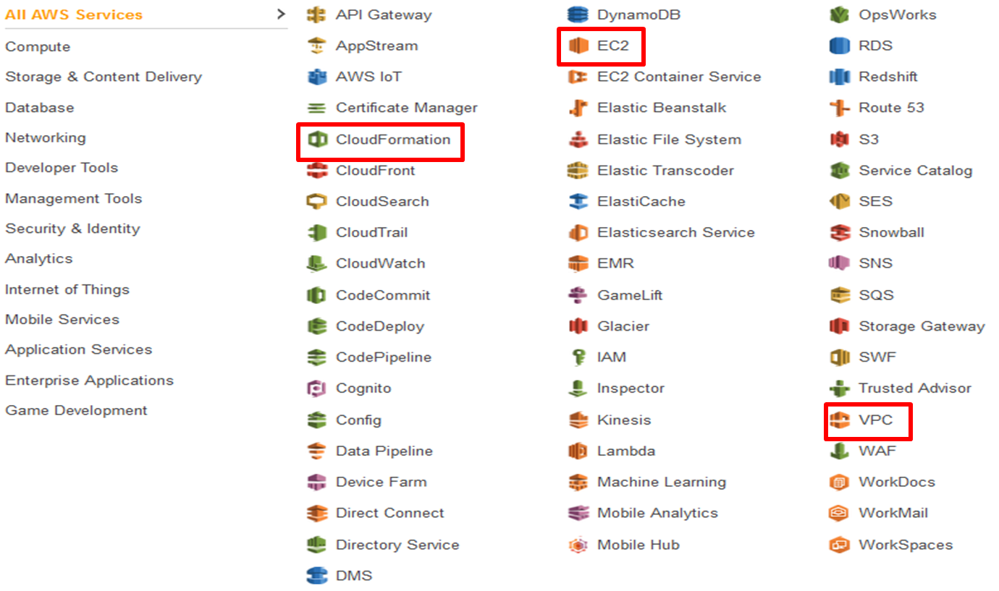
What is Amazon Web Services?
Notes:
These are the services that Amazon web services offers. In this session we will only focus on the Amazon EC2 Instance and the Virtual Private Cloud ( VPC).

Slide 18
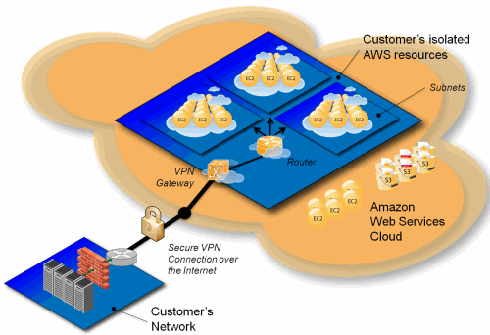
What is Amazon Web Services?
What is Amazon VPC?
Amazon Virtual Private Cloud (Amazon VPC) enables you to launch Amazon Web Services (AWS) resources into a virtual network that you've defined. This virtual network closely resembles a traditional network that you'd operate in your own data center, with the benefits of using the scalable infrastructure of AWS.
What Is Amazon EC2 Instance?
Amazon EC2 provides virtual computing environments known as instances. An EC2 instance is a virtual server in Amazon’s Elastic Compute Cloud (EC2) for running applications on the Amazon Web Services (AWS) infrastructure.
Notes:
Virtual Private Cloud (VPC) enables to setup your own cloud infrastructure by configuring subnets, IP ranges, DMZ, DHCP configurations.
Elastic Cloud Compute (EC2) provides virtual computing environments known as instances. Think of you as virtual computers.

Slide 19
What is AWS Cloud Formation?

Slide 20

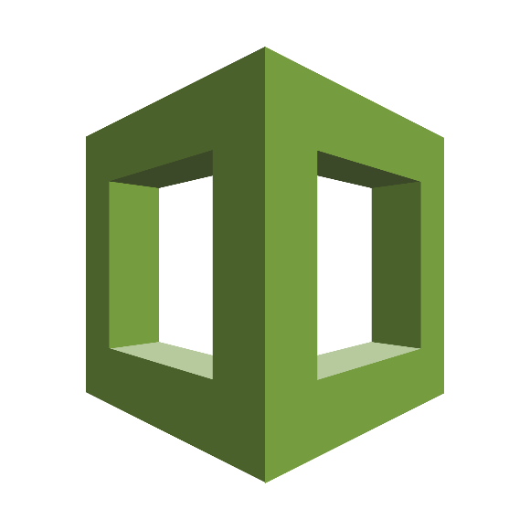

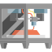
What is AWS Cloud Formation?
Detailed statement
AWS CloudFormation gives developers and systems administrators an easy way to create and manage a collection of related AWS resources, provisioning and updating them in an orderly and predictable fashion.
CloudFormation enables users to model and version control the architecture they want in the CloudFormation template files.
The CloudFormation service can automatically create the desired architecture (CloudFormation stacks) from the template files, without burdening the users with writing complex provisioning code.

Slide 21
Features and Benefits

Slide 22
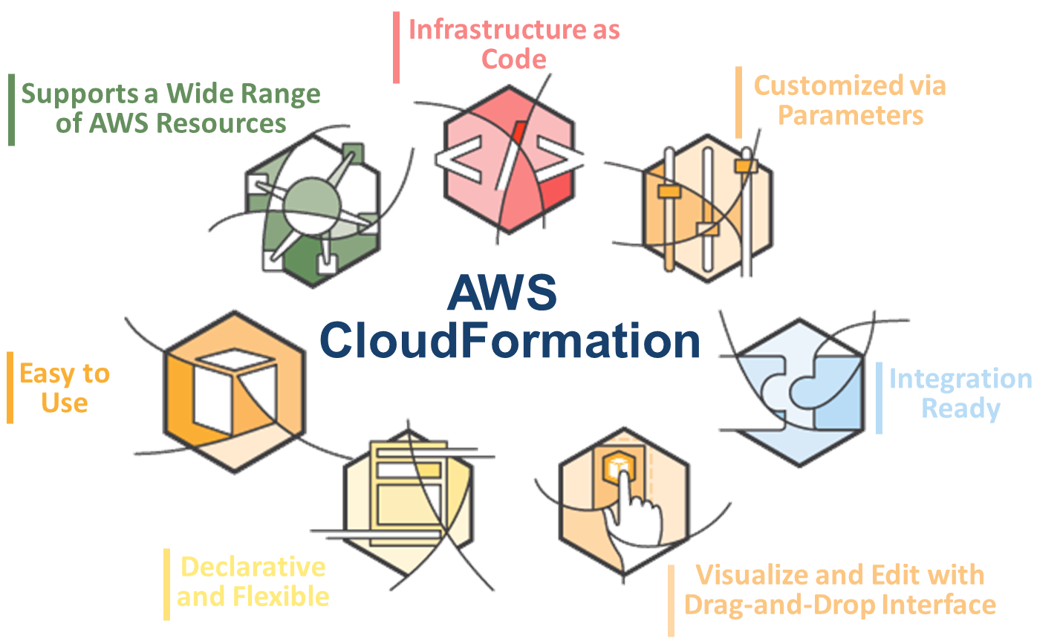
Features and Benefits
Notes:
Supports a Wide Range of AWS Resources
AWS CloudFormation supports a wide range of AWS resources, allowing you to build a highly available, reliable, and scalable AWS infrastructure for your application needs.
Easy to Use
CloudFormation makes it easy to organize and deploy a collection of AWS resources and lets you describe any dependencies or special parameters to pass in at runtime. You can use one of the many CloudFormation sample templates -- either verbatim or as a starting point.
Declarative and Flexible
To create the infrastructure you want, you enumerate what AWS resources, configuration values, and interconnections you need in a template and then let AWS CloudFormation do the rest with a few simple clicks in the AWS Management Console, one command by using the AWS command line interface, or a single requests by calling the APIs. You won’t have to recall the details of how to create and interconnect the respective AWS resources via their service APIs; AWS CloudFormation does this for you. You also don’t need to write a template from scratch if you start with one of the many sample templates that come with AWS CloudFormation.
Infrastructure as Code
A template can be used repeatedly to create identical copies of the same stack (or to use as a foundation to start a new stack). You can capture and control region-specific infrastructure variations such as Amazon EC2 AMIs, as well as Amazon EBS and Amazon RDS snapshot names. Templates are simple JSON-formatted text files that can be placed under your normal source control mechanisms, stored in private or public locations such as Amazon S3, and exchanged via email. With AWS CloudFormation, you can "open the hood," to see exactly which AWS resources make up a stack. You retain full control and have the ability to modify any of the AWS resources created as part of a stack.
Customized via Parameters
You can use parameters to customize aspects of your template at run time, when the stack is built. For example, you can pass the RDS database size, EC2 instance types, database, and web server port numbers to AWS CloudFormation when you create a stack. You can also use a parameterized template to create multiple stacks that may differ in a controlled way. For example, your Amazon EC2 instance types, Amazon CloudWatch alarm thresholds, and Amazon RDS read-replica settings may differ among AWS regions if you receive more customer traffic in the US than in Europe. You can use template parameters to tune the settings and thresholds in each region separately and still be sure that the application is deployed consistently across the regions.
Visualize and Edit with Drag-and-Drop Interface
AWS CloudFormation Designer provides a visual diagram of your template with icons representing your AWS resources and arrows showing their relationships. You can build and edit templates using the drag-and-drop interface, then edit the template details using the integrated JSON text editor. CloudFormation Designer allows you to spend more time designing your AWS infrastructure and less time manually coding your templates.
Integration Ready
You can integrate AWS CloudFormation with the development and management tools of your choice.
AWS CloudFormation publishes progress events through the Amazon Simple Notification Service (SNS). With SNS, you can track stack creation and deletion progress via email and integrate with other processes programmatically.

Slide 23
What is ADOP Blueprint?

Slide 24
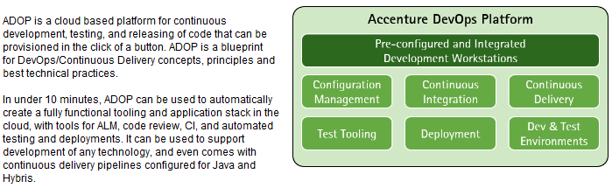
What is ADOP Blueprint?
Accenture DevOps Platform - ADOP
Notes:
Virtual Private Cloud (VPC) enables to setup your own cloud infrastructure by configuring subnets, IP ranges, DMZ, DHCP configurations.
Elastic Cloud Compute (EC2) provides virtual computing environments known as instances. Think of you as virtual computers.

Slide 25
Brief Overview of ADOP GEN5 Architecture

Slide 26
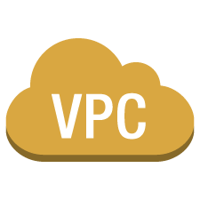





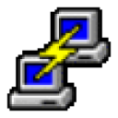
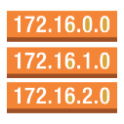




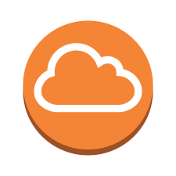








Brief Overview of ADOP GEN5 Architecture
Inner Source
(BitBucket)
Virtual Private Cloud
adop-docker-
compose
Public Subnet
PuttySSH
ADOP Instance
VPN
EC2 Instance
(Jumpserver)
Docker Machine
Administrator
docker
container
Public Route Default
VPC Internet Gateway
docker
container
Users
docker
container
docker
container
Security Group
docker
container
docker
container

Slide 27
Brief Overview of AWS Cloud Formation

Slide 28

Brief Overview of AWS Cloud Formation
Virtual Private Cloud
Stack
Public Subnet
ADOP Instance
Docker Machine
docker
container
Public Route Default
VPC Internet Gateway
docker
container
docker
container
docker
container
Security Group
docker
container
docker
container

Slide 29
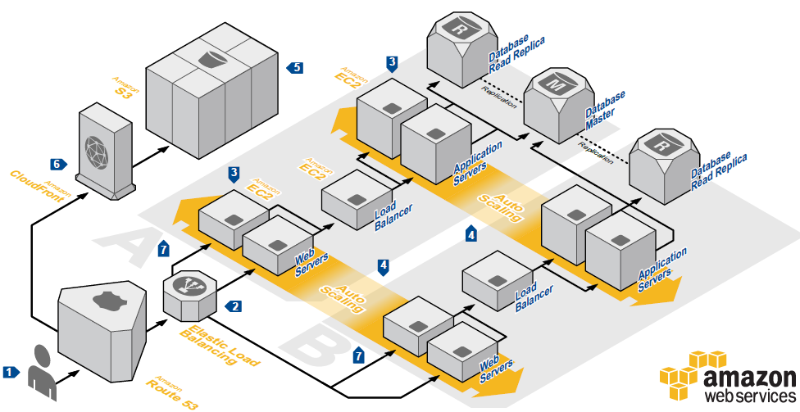


Brief Overview of AWS Cloud Formation
Stack
Template

Slide 30
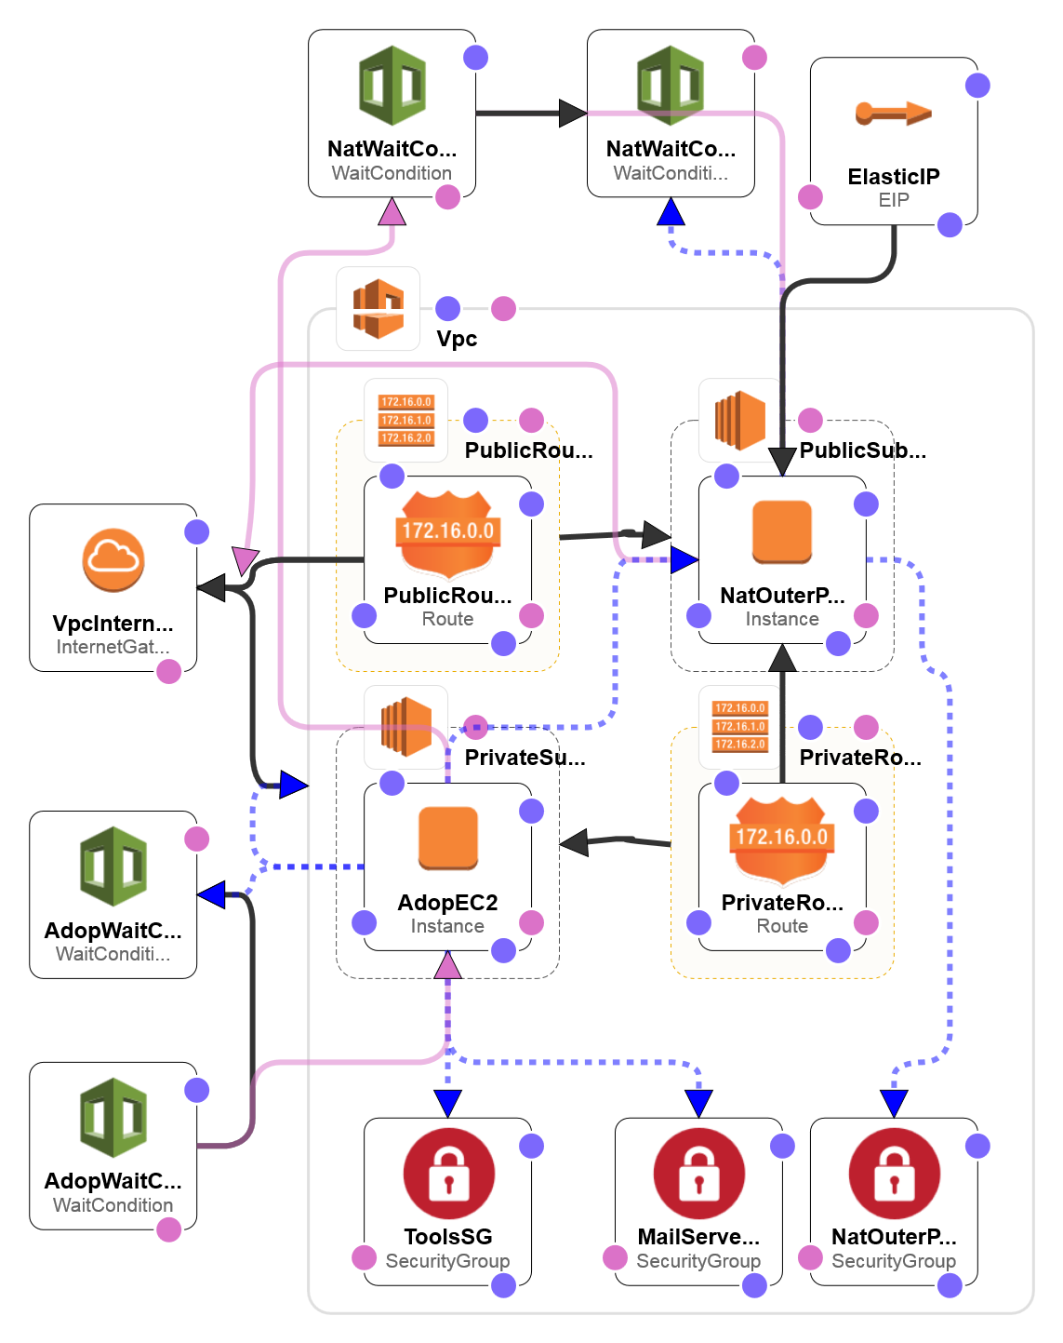
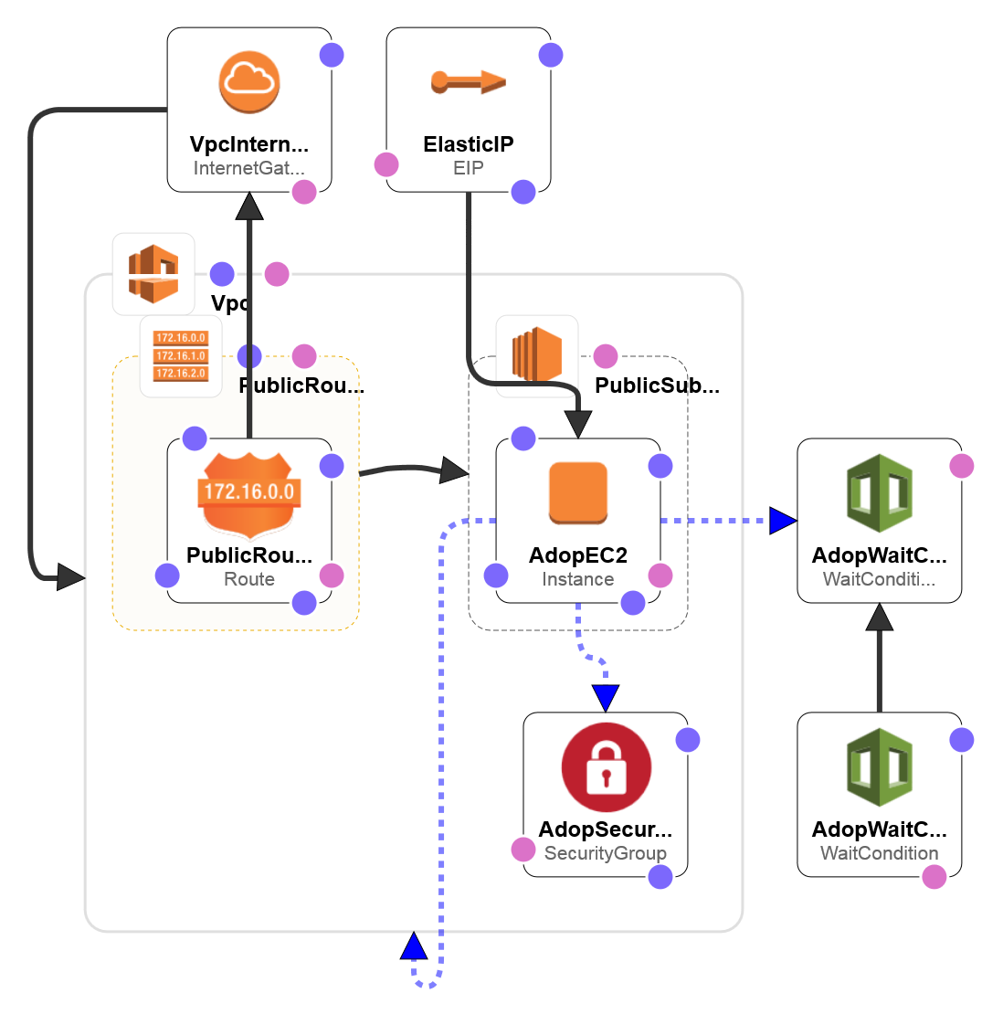
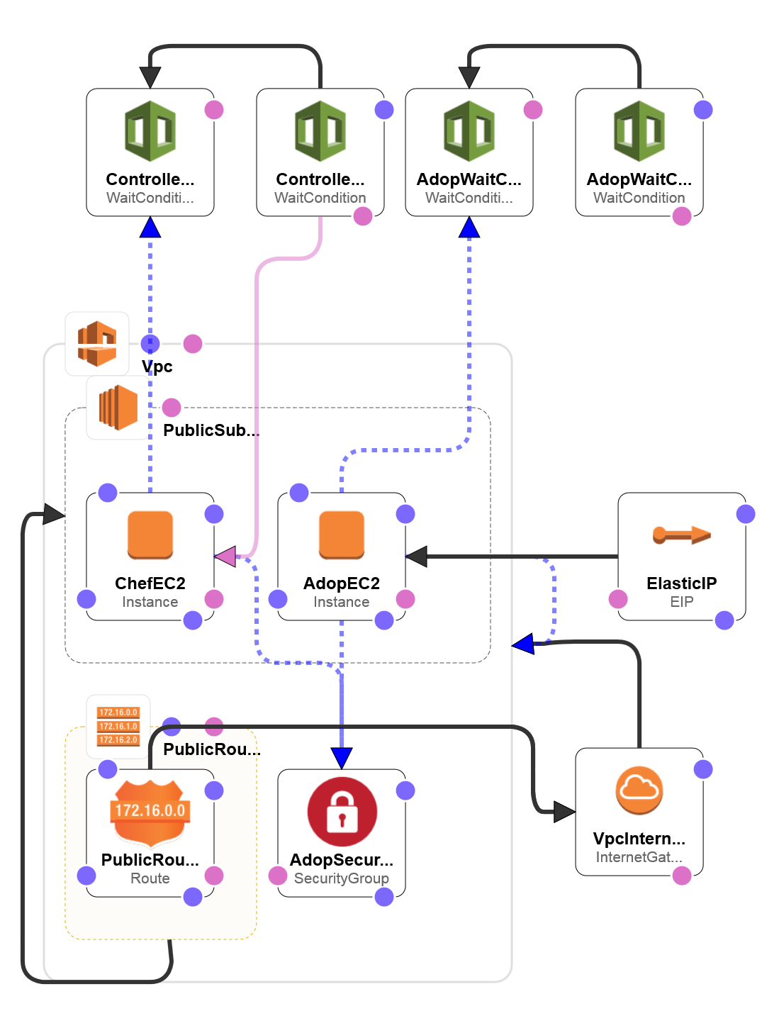
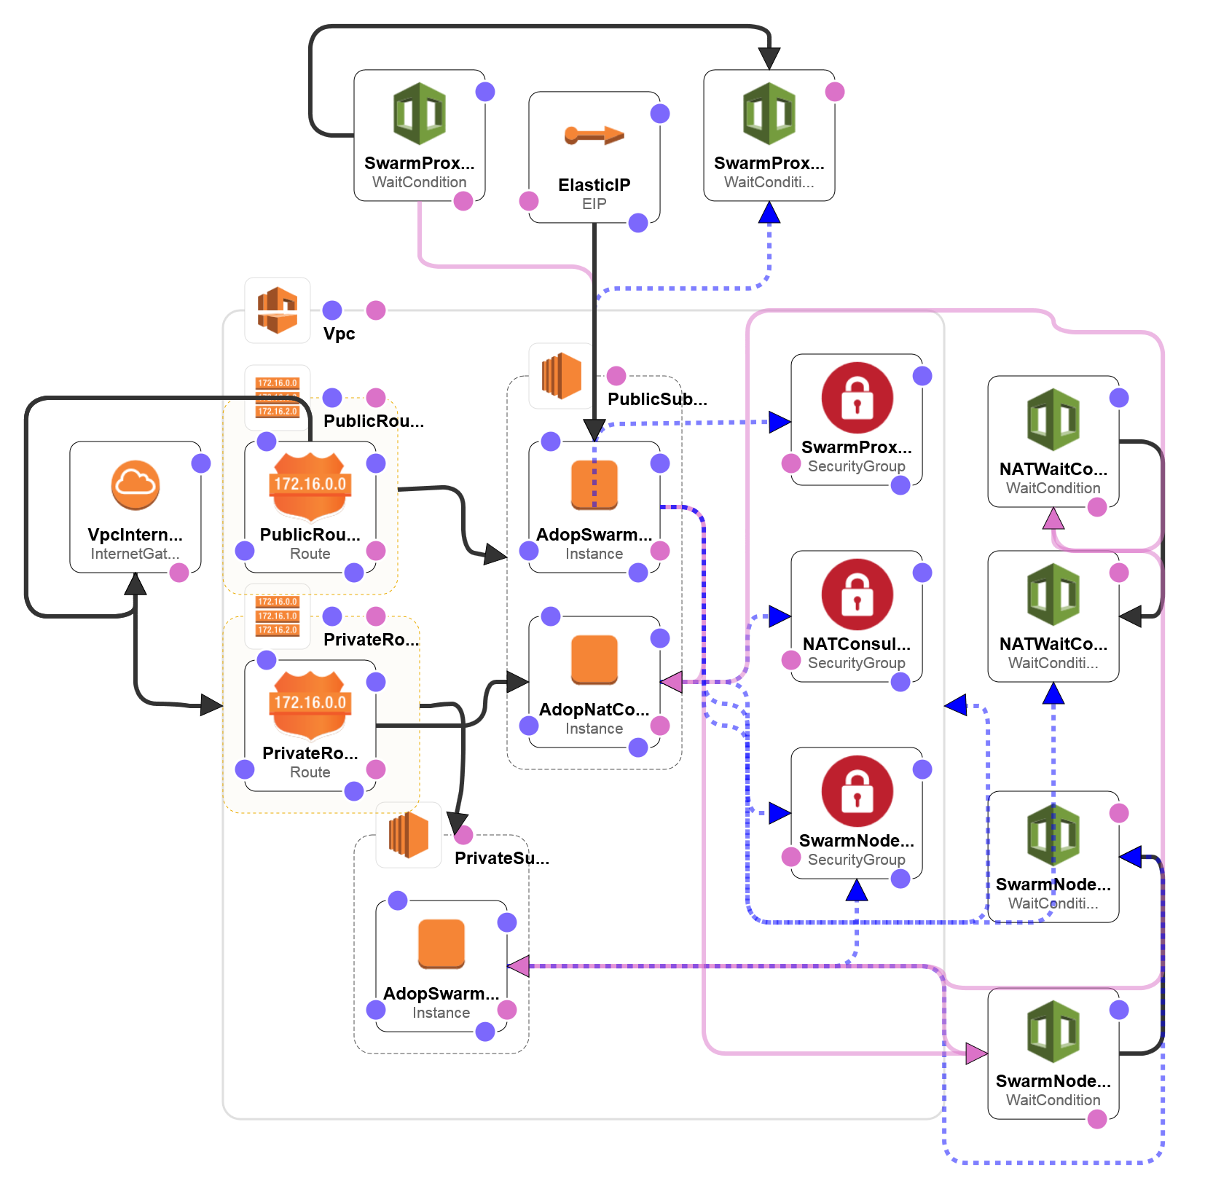
Brief Overview of AWS Cloud Formation
Template

Slide 31
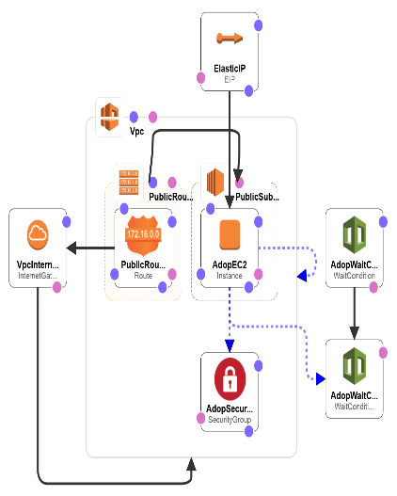
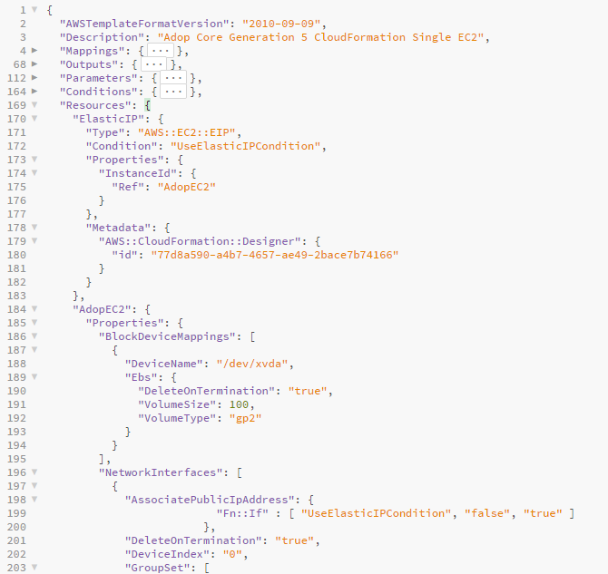
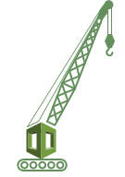
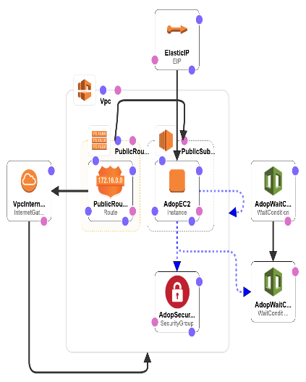
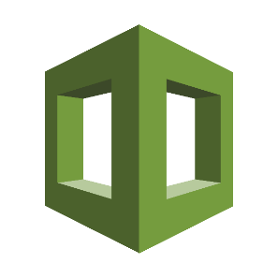
Brief Overview of AWS Cloud Formation
Desired Architecture
Template
Cloud Formation
Generated Stack
Conceptualization
Architecture Layout
Parameter definition
Resource creation
Configuration actions
Comprehensive service support
Service event aware
Customizable
Stack creation
Stack updates
Error Detection and rollback

Slide 32
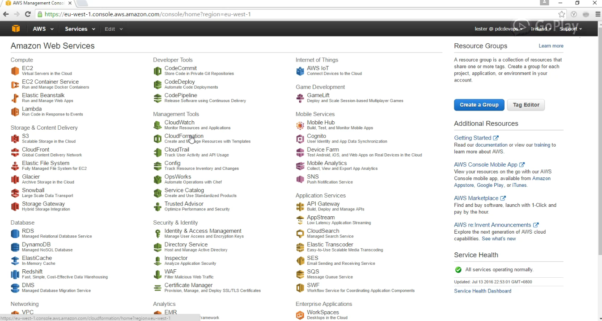
Brief Overview of AWS Cloud Formation

Slide 33
Template Anatomy

Slide 34
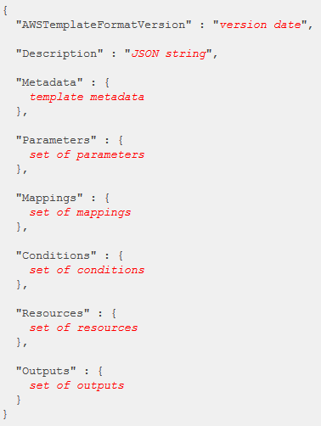
Template Anatomy
A template is a JSON-formatted text file that describes your AWS infrastructure.
Templates include several major sections.
The Resources section is the only section that is required.
The first character in the template must be an open brace ({), and the last character must be a closed brace (}).
Some sections in a template can be in any order.
as you build your template, it might be helpful to use the logical ordering of the previous example, as values in one section might refer to values from a previous section.

Slide 35
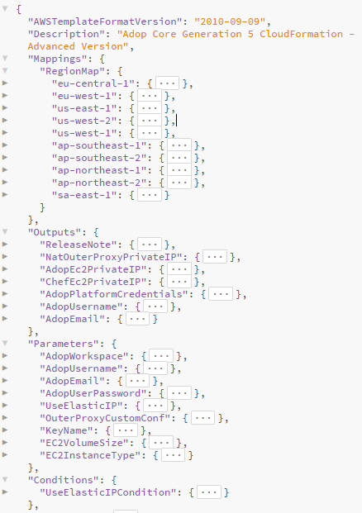
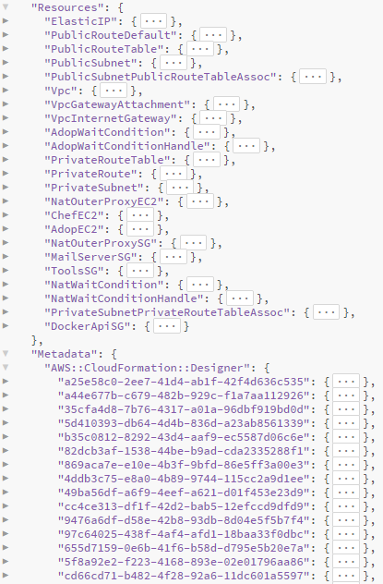
Template Anatomy

Slide 36
Parameterizing Stacks

Slide 37
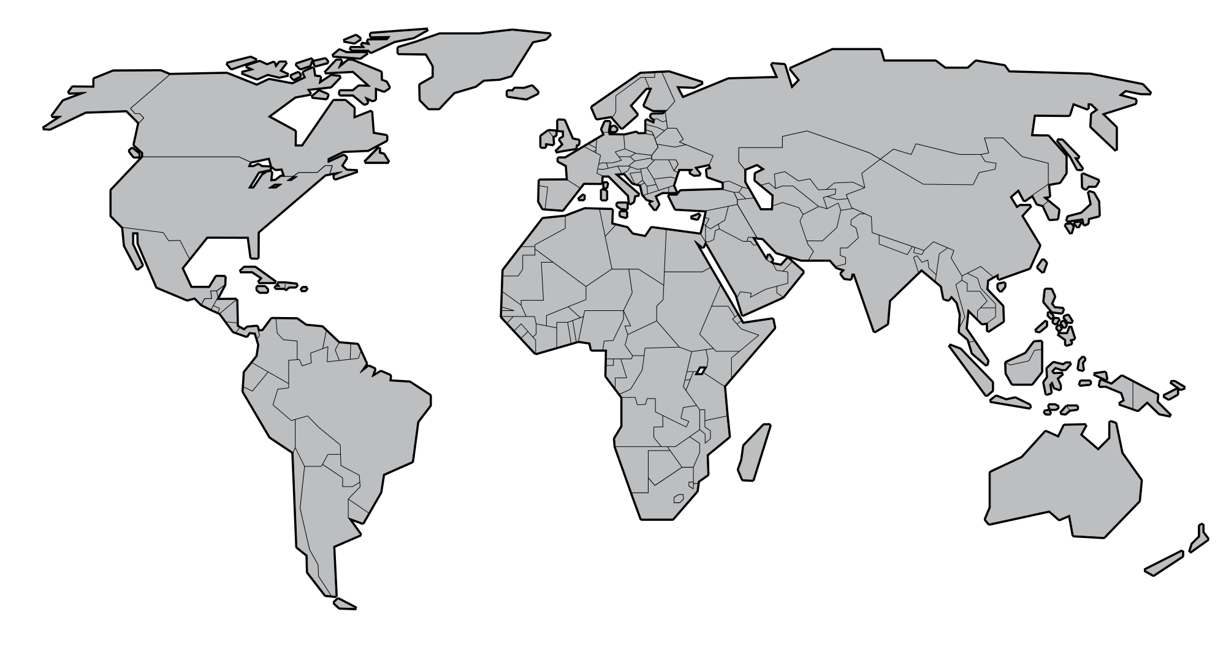
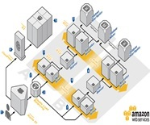
Parameterizing Stacks
Development
Environment
Testing
Environment
Production
Environment
AdopEmail john.smith@accenture.com
AdopUsername
john.smith
AdopUserPassword
********
AdopWorkspace
DevOps
EC2InstanceType
m4.xlarge
EC2VolumeSize
100
KeyName
academy_key.ppk
UseElasticIP
true
AdopEmail john.smith@accenture.com
AdopUsername
john.smith
AdopUserPassword
********
AdopWorkspace
DevOps
EC2InstanceType
m4.large
EC2VolumeSize
50
KeyName
academy_key.ppk
UseElasticIP
true
AdopEmail jane.doe@accenture.com
AdopUsername
jane.doe
AdopUserPassword
********
AdopWorkspace
DevOps
EC2InstanceType
m4.10xlarge
EC2VolumeSize
1000
KeyName
academy_key.ppk
UseElasticIP
true

Slide 38
DEMO

Slide 39
DEMO
Access Amazon Web Services
Navigate to AWS Cloud Formation
Create a Template (Manual/Designer)
Create a Stack
Update a Stack
Delete a Stack
Access the Landing Page
Notes:
Virtual Private Cloud (VPC) enables to setup your own cloud infrastructure by configuring subnets, IP ranges, DMZ, DHCP configurations.
Elastic Cloud Compute (EC2) provides virtual computing environments known as instances. Think of you as virtual computers.

Slide 40
Best Practices for AWS Cloud Formation

Slide 41
Best Practices for AWS Cloud Formation
Use Cloud Formation Designer to validate templates to make sure that the templates are well-written and well-structured to avoid rollbacks.
Use version control to log changes in the template.
Integrate templates with other development tools, CI/CD and management tools.

Slide 42

QUesTIONS

